Slide 1
Employee Attrition - Exploratory Data Analysis (EDA)
Employee attrition is the naturally occurring, voluntary departure of employees from a company. Employee attrition involves leaving a job for: Personal reasons. Professional motivation. Job mismatch.
Employee attrition can happen for several reasons. These include unhappiness about employee benefits or the pay structure, a lack of employee development opportunities, and even poor conditions in the workplace.
By:-
Sidhant Jain (D22046)
Arnab Mondal (D22009)
Manoj (D22030)
Google Colab Link

Slide 2
Business objective of our project
The objective of this project is to predict the attrition rate for each employee, to find out who’s more likely to leave the organization.
It will help organizations to find ways to prevent attrition or to plan in advance the hiring of new candidate.
Attrition proves to be a costly and time consuming problem for the organization and it also leads to loss of productivity.
The scope of the project extends to companies in all industries.

Slide 3
Univariate Analysis
Attrition (Discrete Feature)
There are 1470 employees, 237 employees who compose 16% of the total number of employees in the company. Besides that, 1233 employees are currently working in the company.
There is 16% attrition in the company which can be considered moderate level.
2. Business Travel (Categorical Feature/Ordinal Data)
Around 71% of employees travel rarely(1043), 19% of employees(277) travel frequently and 10% of employees are non travellers(150) in the company.
3. Department (Categorical Feature)
In the Company, around 65% of employees work in Research & Development(961), 30% in Sales(446) and around 4% in Human Resources(63).
4. Education Field (Categorical Feature)
In the Company, 41% of employees are from Life Sciences(606), 31.5% of employees are in Medical(464), 11% of employees are in Marketing and lowest is in Human Resources 1%.
5. Gender (Categorical Feature)
In the company around 60% of the employee are male(882) and 40% of the employee are male(588).
So, the gender ratio stands at 3:2.

Slide 4
6. Marital Status (Categorical Feature)
In the company, 46% of employees are married in the company, 32% of employees are single and 22% of employees are divorced.
7. Overtime (Categorical Feature)
Around 72% of employees do not work overtime in the company, whereas 28% of employees do work overtime in the company.
8. Environmental Satisfaction (Discrete Feature)
In the Company around 20% of the employees rated for environmental satisfaction on the scale 1, 2 each and 30% of the employees rated 3 to 4 each on the environmental satisfaction.
9. Work Life Balance (Discrete Feature)
In the Company, 60% of employees rated for work life balance on the 3, 10% of employees rated 4 while 24% and 6% rated 2 and 1 respectively.
10. Job Involvement (Discrete Feature)
In the Company, 59% of employees rated for Job Involvement on the 3, 10% of employees rated 4 while 25% and 6% rated 2 and 1 respectively.

Slide 5
11. Job Levels (Discrete Feature)
In the Company, 36% of employee are on Job level of 1 & 2 respectively. This implies around 3/4th of employees are at very young age of career.
12. Job Satisfaction (Discrete Feature)
In the Company, 61% of employee are satisfied with their job and 40% are not satisfied with their job.
13. Age (Continuous Feature)
14. Monthly Income (Continuous Feature)
Maximum monthly income of employee is 19999 & Min. is 1009 in the company.
25% of employees have monthly income less than 2911 in the company.
50% of employee have monthly income less than 4919 in the company.
75% of employee have monthly income less than 8379 in the company.
25% of employee have monthly income greater than 8379 in the company.
Youngest employee is 18 years old.
Oldest employee is 60 years old.
75% of employees have age less then 43 in the company.
Only 25% of employees have age greater than 43 year's.
Age distribution is little bit skewed towards right.
Range of age is from 18 to 60 years in the company.

Slide 6
15. Total Working Years (Continuous Feature)
16. Years at Company (Continuous Feature)
Max. Working years is 40 years and Min. Working years is 0 year in the company.
25% of employee's have less than 6 years of total working years.
50% of employee's have less than 10 years of total working years.
75% of employee's have less than 15 years of total working years.
Total Working years distribution is positively skewed.
Max. years at company is 40 years and Min. years at company is 0 year.
25% of employees have years at company less than 3 years.
50% of employees have years at company less than 5 years.
75% of employees have years at company less than 9 years.
Year's at working in the company is positively skewed.
17. Years in Current Role (Continuous Feature)
18. Years since last Promotion (Continuous)
Maximum years for employee in current is 18 years and minimum years is 0 int
25% of employee in the company have year's in current role less than 2.
50% of employee in the company have year's in current role less than 3.
75% of employee in the company have year's in current role less than 7.
Maximum years it took to promote an employee is 15 and minimum is 0 in the company.
On an average it takes 2 years to promote an employee in the company.
25% of employee get promotion in less than 0 years.
50% of employee get promotion in less than 1 years.
75% of employee get promotion in less than 3 years.
Years since last promotion data is positively skewed.

Slide 7
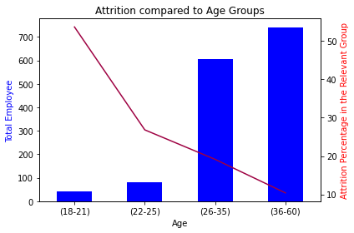
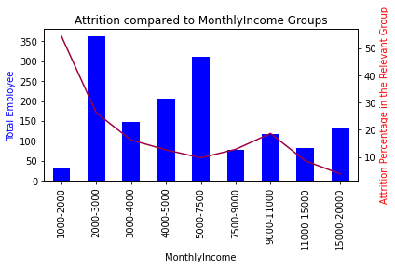
Bivariate Analysis
How is Attrition dependent on Age?
Is Income a factor towards Attrition?
In 18-21 age group, young employees are more likely to leave the company. Their attrition proportion to their age group is approximately 53.7% (22 out of 41) and that makes up 9% of all attrition (22 out of 237).
If we evaluate overall attrition number in the company, 26-35 age group's attrition number is the highest comparing to other age groups
2000-3000 dollars monthly income level, there is a high attrition and it compose the 40% of attrition in the company.
1000-2000 dollars monthly income level, there is a high attrition in its own income group level, which is 54.5%.
As the monthly income increase, it is observed that there is a decrease in attrition.

Slide 8
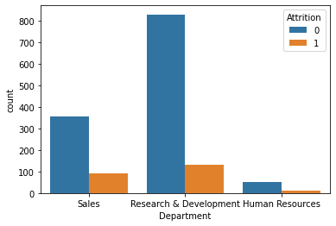
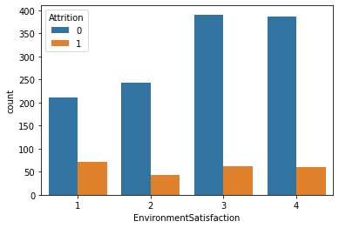
Does Department impact Attrition?
How Environment Satisfaction impact
Attrition?
13.8% of Research & Development Department employee left the organization. In numbers, it is equal to 133, which makes us the 56.1% of all attrition in the company.
Sales Department has mostly been affected by the attrition. Because 20.6% of its employees left the organization.
Human Resources Department follows the Sales Department in terms of being affected by attrition itself. 19% of that department employee left the company.
As it may be expected, there is a high attrition rate in the low satisfaction environment(1). That composes the 30.4 % of the whole company's attrition.
In the high and very high(3&4) satisfaction environment, there are still 13.7 % of the these each group's employees leave the company.
That attrition composes of the 51.5 % of the whole company's attrition.

Slide 9
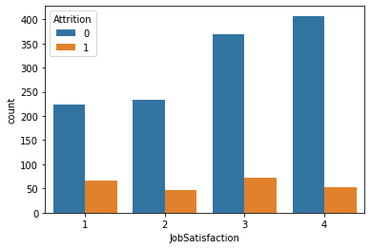
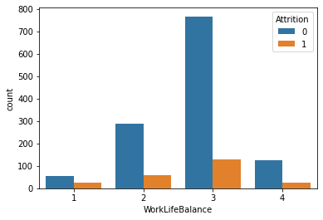
How does job satisfaction impact the Attrition?
How does Work Life Balance impact the attrition?
In high (3-4) job satisfaction, surprisingly employees leave the company most and their attrition composes 30.8% of company's attrition.
As it may be expected, in low(1-2) job satisfaction, employees leave the company more than other groups except high satisfaction. They compose 27.8% of all attrition in the company.
In general, work life balance is satisfactorily good throughout the company. But we have the highest attrition number and percentage throughout the company.
Besides, bad work life balance group has highest attrition percentage in its individual group.

Slide 10
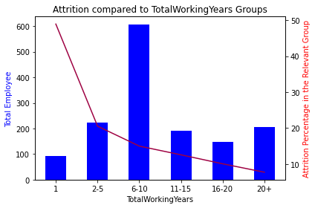
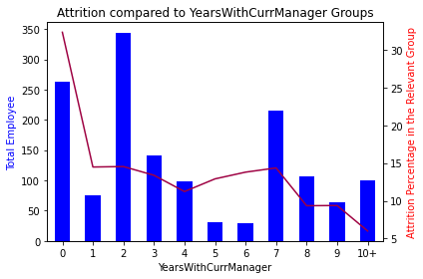
How does Work Experience affect Attrition?
Are managers a reason for people resigning?
Employees who have one year or less working experience are more likely to leave the company and compose the 18.98% of all attrition throughout the company.
In addition to that, employees who have 6-10 years' experience have also second highest attrition percentage throughout the company and it compose the 38.4% of all attrition.
Most of the employee quit the company before completing their first year with their current manager.
Other group who leaves the company most is the ones who work two years with current manager.

Slide 11
Conclusion
People are tending to switch to a different jobs at the start of their careers, or at the earlier parts of it. Once they have settled with a family or have found stability in their jobs, they tend to stay long in the same organization- only going for vertical movements in the same organization.
Salary have a great motivation on the employees and people tend to leave the organization much lesser. Higher pay have seen more employees remain loyal to their company.
Work life balance is a great motivation factor for the employees. However, people with a good work-life balance, tend to switch in search of better opportunities and a better standard of living.
People with a good Job Satisfaction and Environment satisfaction are loyal to the organization. However, people who are not much satisfied with their current project- tend to leave the organization far more.

